Slide 1
PSAtlas
An interactive Powershell learning framework
@_bateskevin

Slide 3


Slide 4
Agenda
What PSAtlas is
How you consume knowledge
How you share your knowledge

Slide 5
What PSAtlas is

Slide 6
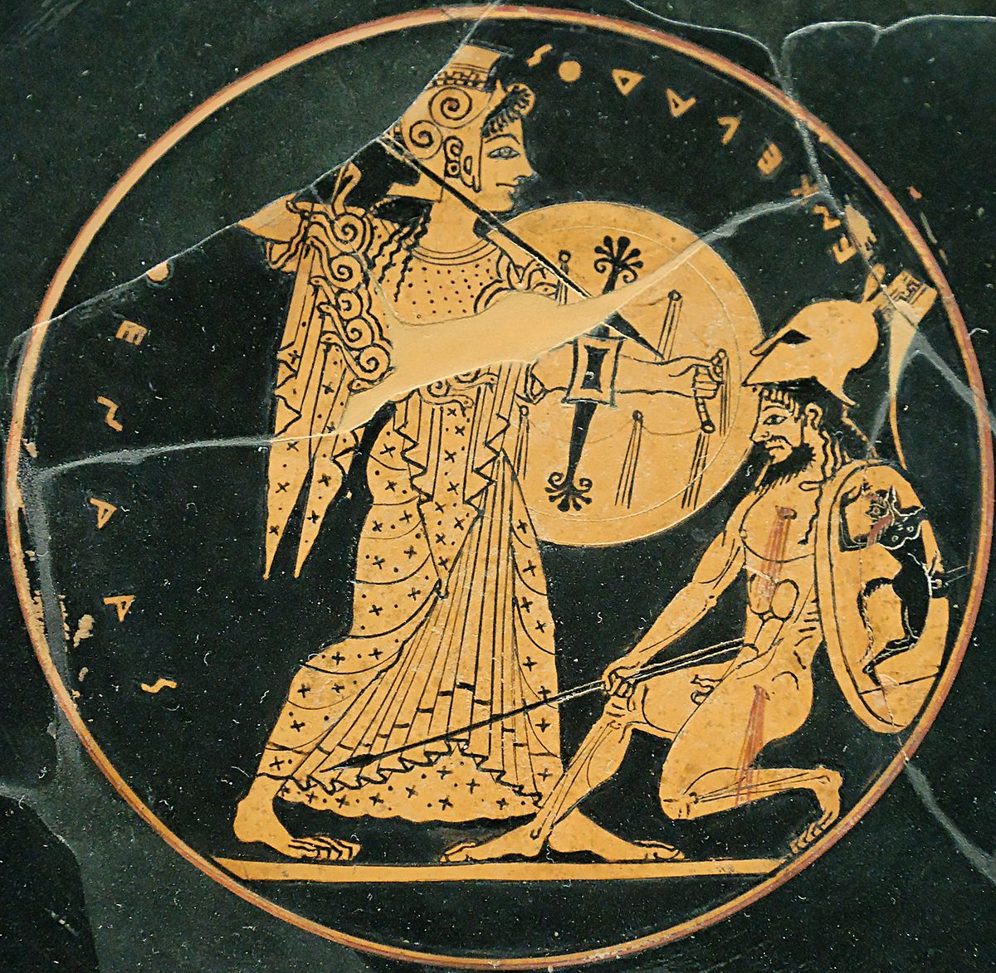
Early Ages of Greek Mythology

Slide 7

It's not about that…

Slide 8
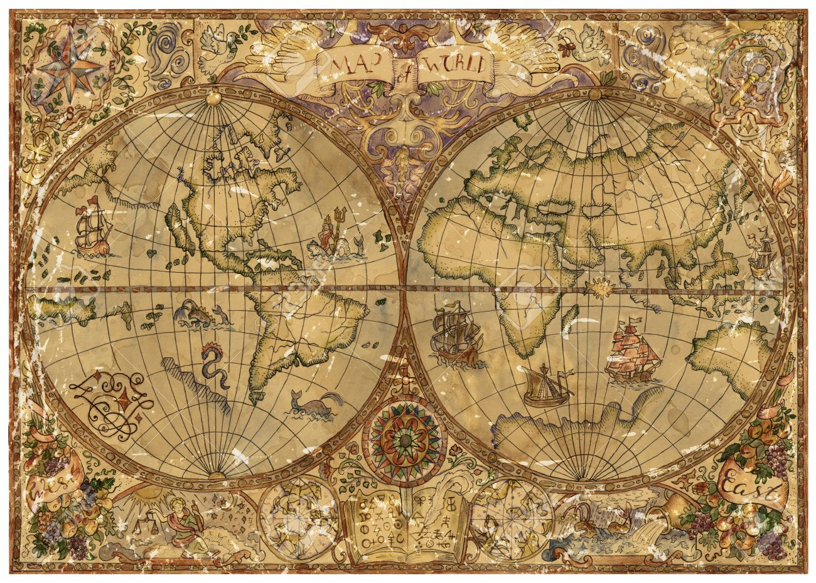
Atlas

Slide 9
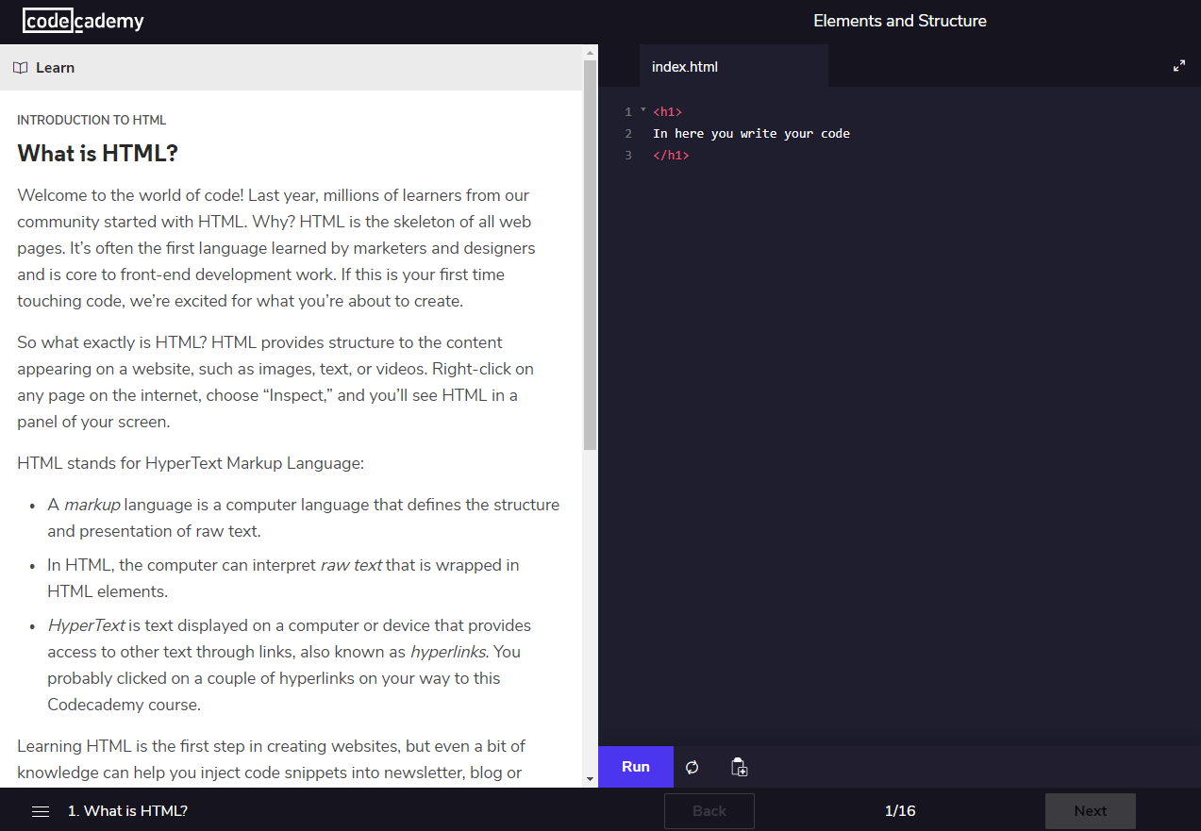


Inspired by Codeacademy

Slide 10
How you consume knowledge

Slide 11
Guides and Steps
A Guide is like a Course
A step is one task in that Guide
Guide
Powershell datatypes
Step 1
Step 2
Create a String
Create a int

Slide 12
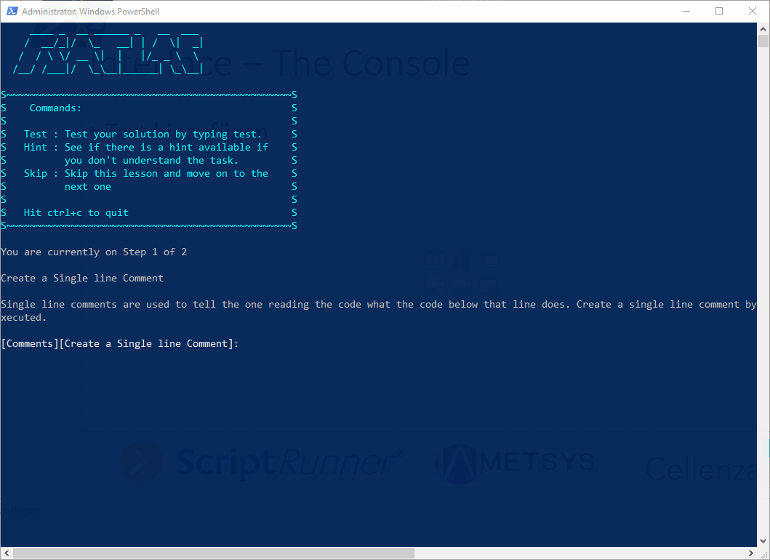
Interface – The Console

Slide 13
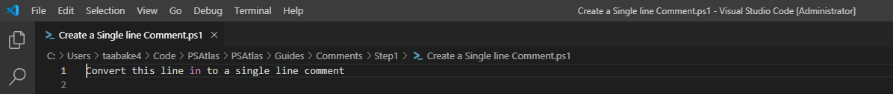
Editor – VSCode/ISE

Slide 14
Cmdlets
Get-AtlasGuide
Start-AtlasGuide
Clear-AtlasGuide

Slide 15
Get-AtlasGuide

Slide 16
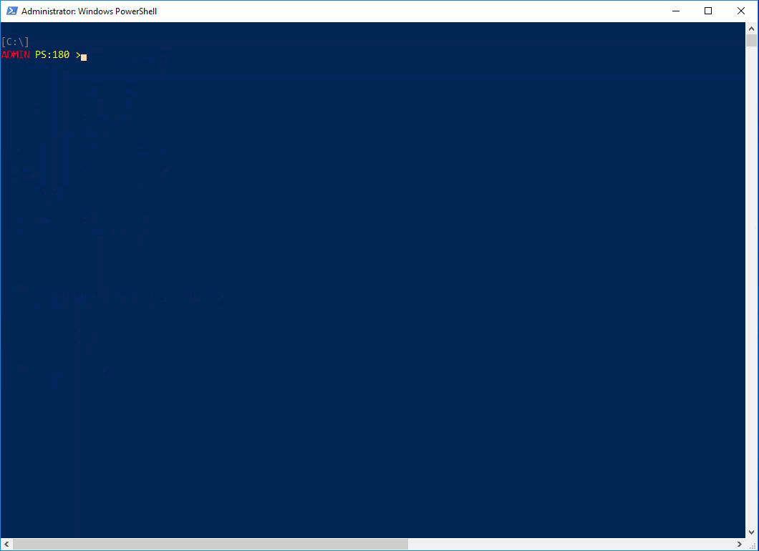
Get-AtlasGuide

Slide 17
Start-AtlasGuide

Slide 18

Start-AtlasGuide

Slide 19
Clear-AtlasGuide

Slide 20
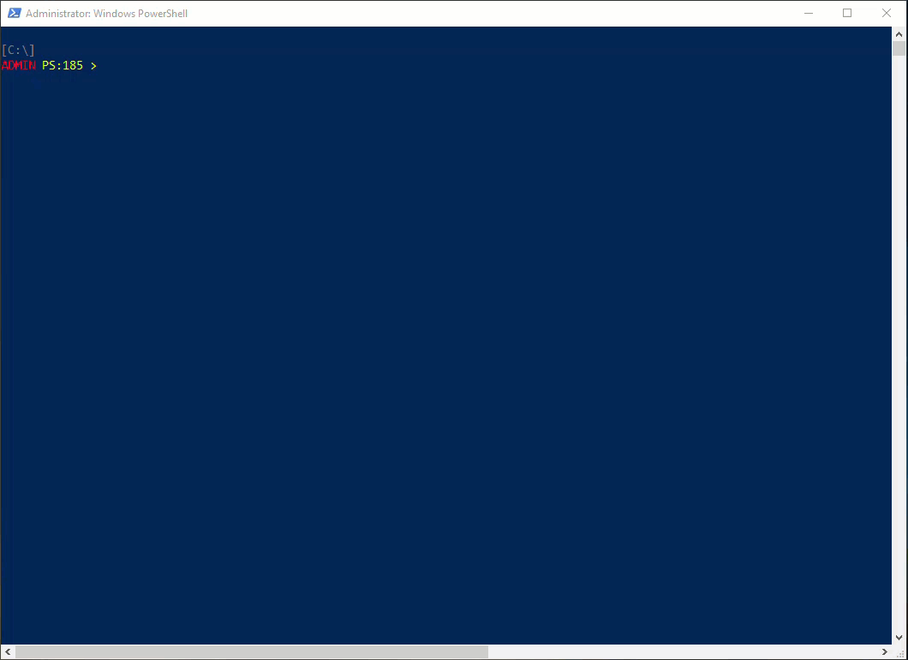
Clear-AtlasGuide

Slide 21
How you share your knowledge

Slide 22

Set your topic

Slide 23
Convert your idea in a guide
What is the overall title for a Guide?
What steps are involved in learning about that topic?

Slide 24

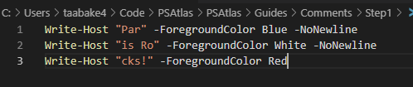
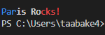
Pester Test and Code Templates

Slide 25
Cmdlets
New-AtlasGuide
New-AtlasStep

Slide 26
New-AtlasGuide
DEMO VIDEO

Slide 27
New-AtlasStep
DEMO VIDEO

Slide 28
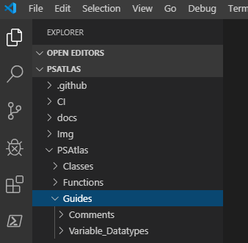
Add your Guide
Add the folder to the Guides folder in your fork
Create a Pull request (seriously, do it. It's Hacktober ;) )

Slide 29
Conclusion
Interactive learning framework
Suitable for both
People interested in learning
People interested in sharing
Documentation can be found here https://github.com/bateskevin/PSAtlas

Slide 30


French PowerShell Saturday
Questions?

